Slide 1
Bellabeat
4/13/2022
By Heather Shaw

Slide 2
Business Task
Identify trends in non-Bellabeat smart tracker devices.
Identify ways these trends could apply to Bellabeat customers.
Apply these trends to influence Bellabeat marketing strategy.

Slide 3
The Data
FitBit Fitness Tracker Data – made available by Amazon Mechanical Turk
31 days of fitness tracker data
33 participants
Date Range 4.12.2016 – 5.12.2016
Considerations
Short duration
Small sample size
Dated – six years
Gaps in some metrics

Slide 4
The Data
*Tracker input for daily activity, including:
Activity level / intensity
Activity time
Distance
Calories
*Sleep input, including:
Sleep time
Total time in bed
Sleep input
*Weight tracker
*Additional tables for measurements by hour or minute

Slide 5
Data Cleaning
SQL
Transformed string data types into dates and numeric values to prepare for calculations
Deleted 3 duplicate rows from the Sleep table
Checked for missing or incomplete data.
During this step, a wide variation between the number of entries in the Daily Activity, Sleep, and Weight tables was observed.
Many entries where all metrics were measured as 0.

Slide 6
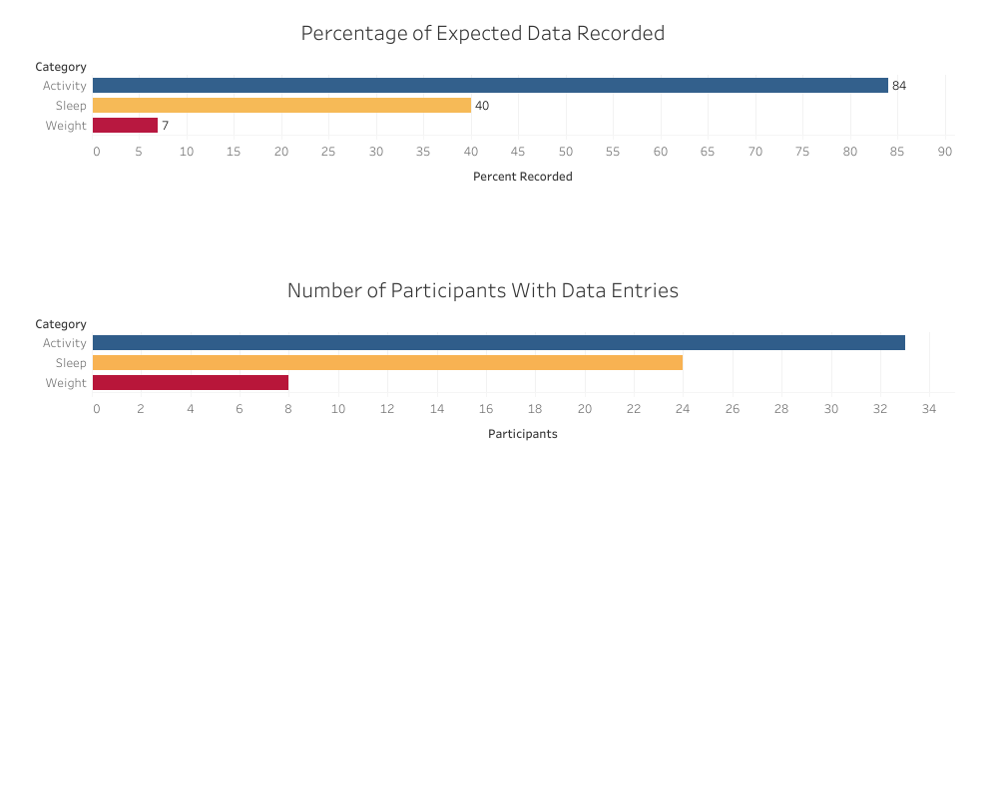
Calculating for 31 entries from 33 participants, a complete data set would be expected to include 1,023 entries for each daily measurement.
All participants had entries for Daily Activity, but there were missing values for Sleep and Weight tracking.

Slide 7
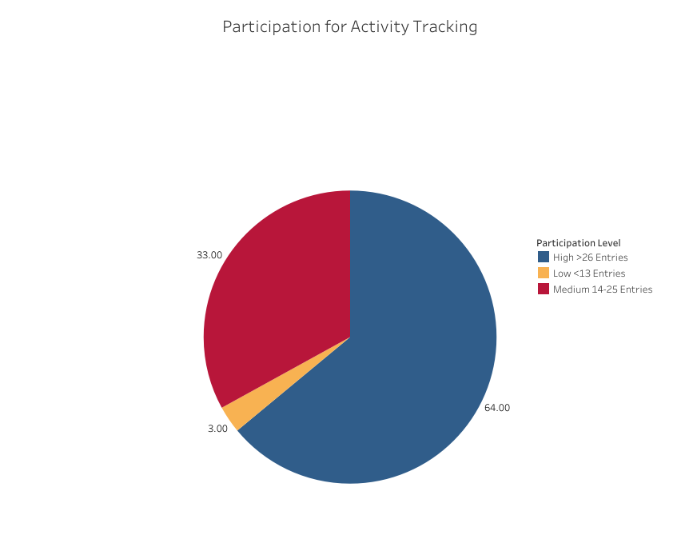
Daily Activity had the most consistent data.
Participants were grouped by level of participation - the number of Daily Activity entries over the 31-day study period.

Slide 8
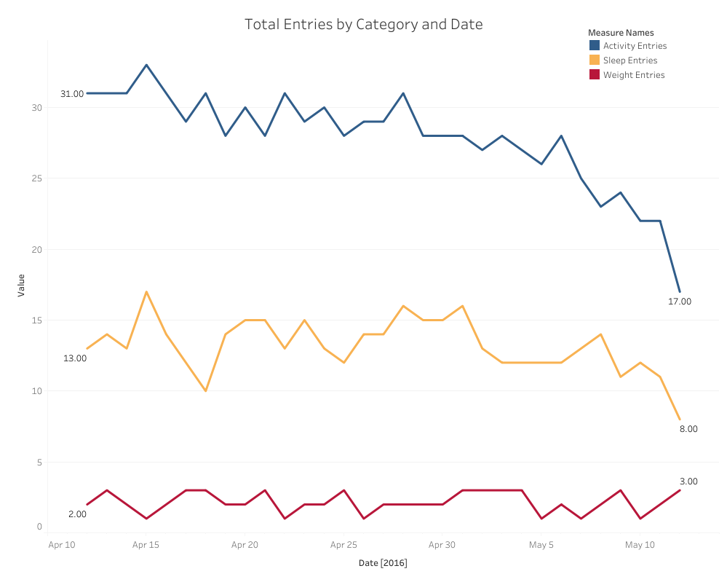
Daily Activity had the most consistent data, but participation lagged during the last week of the study
Daily Sleep had 24 participants, but the number of daily entries only ranged between 8 – 17.
Only 8 participants logged weight at any point in the study.

Slide 9
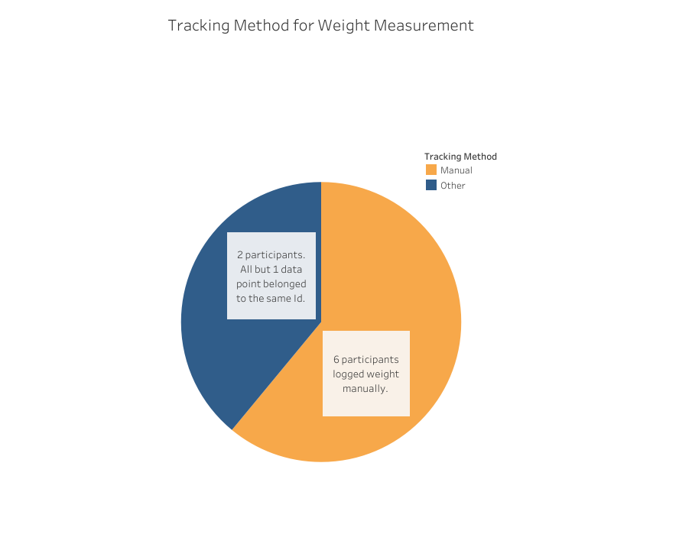
Consideration of how users are tracking weight data.
Data is extremely limited for this metric.

Slide 10
Analysis
The most frequently recorded data was activity input directly from the FitBit.
There are large gaps in the data for sleep and weight measurements.
Why? Potential causes:
Comfort of device while sleeping
Lack of interest in tracking this information
Ease / convenience of using smart devices for tracking weight
There are significant limits to this data: limited time, small sample size, and age of data are all factors that could affect these results.

Slide 11
Bellabeat Products & Implications
Leaf
Classic wellness tracker that can be worn as a bracelet, necklace, or clip. If comfort or fashion is a consideration in use of product, the versatility of how the product is worn could have a positive impact on potential customers’ decision to purchase the product.
Connects to app that allows users to track and view their health data.
Include a feature for users to track some data manually, like weight or hours of sleep if a user does not have a smart scale or want to wear the device while sleeping.
Include optional notifications to remind users to track some data manually, if desired.
Include a feature to allow input to the app from smart scales that are non-Bellabeat products.

Slide 12
Bellabeat Products & Implications
Spring
Water bottle that tracks daily water intake using smart technology
Connects to app so users can track hydration levels.
Automated data input from the fitness tracker had the most consistent use throughout the study period. Users interested in tracking water intake could find this feature very appealing.

Slide 13
Recommendations
Up-to-date tracker data from customers currently using Bellabeat products
Survey data
Gain insights from current and potential users about the factors that impact their decision to purchase and consistently use fitness trackers.
Clarify which metrics potential users wish to track.

